Slide 1
Running Start Parent Information Session

Slide 2

Who is Successful in Running Start?
Independent learners
Students ready for adult learning environment
Students with good organizational and time management skills
Students with a good support system
Students unafraid to ask for help
Students who can balance school, work, & other responsibilities
Notes:
Since you are considering Running Start, it’s important to understand what it takes to be successful. When you do Running Start, you are starting your college transcript. That’s a big deal! You want to make sure that this is a good fit for you. We have many support systems on campus to help you through your time here, but college is definitely different than high school. Our most successful Running Start students are independent learners, which means that they don’t need someone to keep track of assignments and deadlines for them. They are ready to take classes in an adult environment among students from a variety of ages, backgrounds, and life experiences. They are great at balancing high school, college, work, home, and all of the other responsibilities they might have. Having a strong support system at home and at your high school really helps with that! Mostly, these successful students are ones who are totally willing to ask for and seek out help if they need it. Recognizing when you need assistance with something and being willing to ask for help is going to make your time in college a lot easier!

Slide 3

Short term vs. long term goals
Completing your high school diploma
Completing an Associate’s Degree
Career Planning
Transfer Planning

Slide 4

Degree Overview
Degree Levels
*
Certificate of Completion
*
Associate Degree (AA/AS)
Bachelor’s Degree (BA/BS)
Master’s Degree (MA/MS)
Doctor of Philosophy Degree (PhD)

Slide 5
Running Start Students & Degrees
Primary focus on high school diploma completion
Take an average of 15 college credits per quarter for six quarters total
Many Running Start students complete their associate degree after high school graduation and then transfer on to a four year school
Students must order transcripts from SPSCC to be sent on to other colleges or employers or military recruiters
RS students apply to the four year as a freshman applicant if going right after HS graduation

Slide 6

Graduating with AA when you are exploring
Focus on high school graduation requirements
Complete general education requirements (English, Diversity and Math)
Please meet with an Educational Planner if you are interested in Science, Engineering or Math
Supportive adults can be part of the process- they just can’t do it for their student!
Notes:
Since you are considering Running Start, it’s important to understand what it takes to be successful. When you do Running Start, you are starting your college transcript. That’s a big deal! You want to make sure that this is a good fit for you. We have many support systems on campus to help you through your time here, but college is definitely different than high school. Our most successful Running Start students are independent learners, which means that they don’t need someone to keep track of assignments and deadlines for them. They are ready to take classes in an adult environment among students from a variety of ages, backgrounds, and life experiences. They are great at balancing high school, college, work, home, and all of the other responsibilities they might have. Having a strong support system at home and at your high school really helps with that! Mostly, these successful students are ones who are totally willing to ask for and seek out help if they need it. Recognizing when you need assistance with something and being willing to ask for help is going to make your time in college a lot easier!

Slide 7
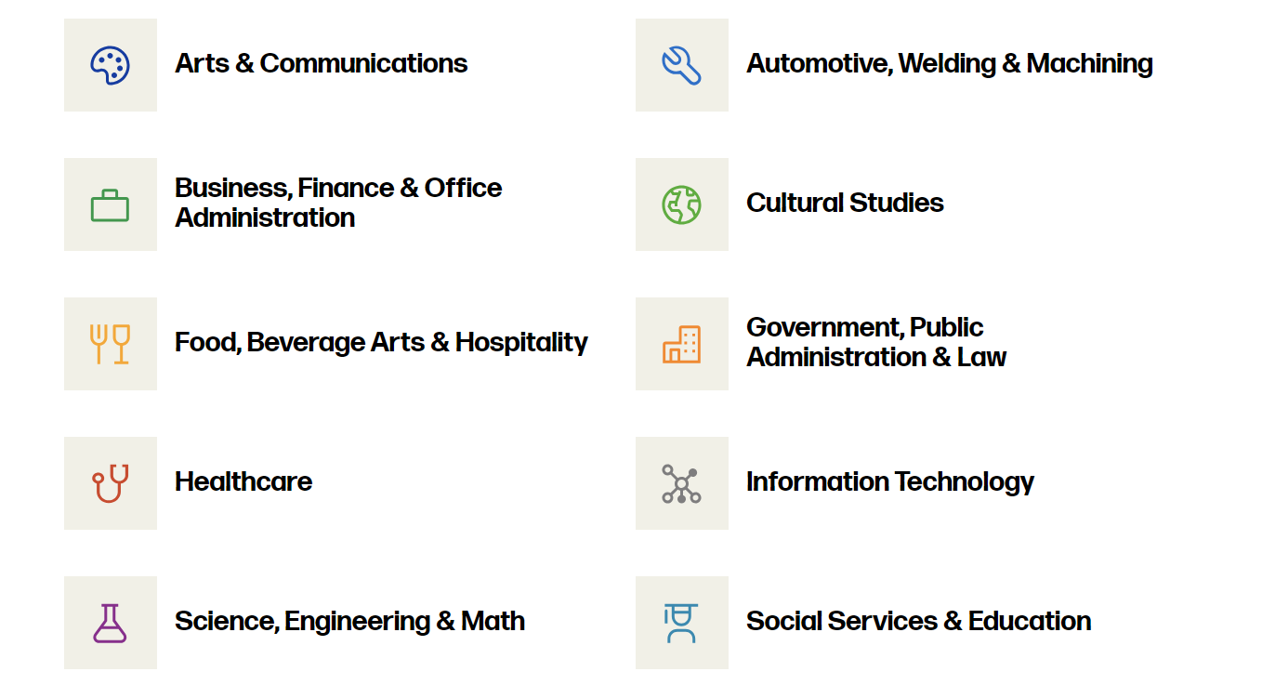
Explore/narrow pathway
Pathways are not a degree
They help to work toward the end goal
Career Planning/CCS 102*
*CCS 101/102 may help to complete the High School and Beyond plan.

Slide 8

Cost of Running Start
Running Start is not 100% free;
Tuition is waived for up to 15 credits per qtr
  Save up to $1,350.00 per quarter
Students are still responsible for the cost of:
Total costs can vary from $300-$800+ per quarter,
depending on: 1) class type, 2) books required, or 3) credits enrolled
Course & Student fees
(lab, technology, supplies, student activities)
Tuition for pre-college courses & credits over funding limits (per RS EVF)
All other costs
(books, supplies, transportation etc)
Notes:
As we mentioned before, Running Start is an amazing cost-saving option. One important thing to note, however, is that it is not completely free. Tuition for up to 15 credits is waived each quarter through that verification form. That’s a significant savings, but there are other costs associated with taking those classes that you should plan for. Each course has fees attached, there may be textbooks and supplies, and you may have to consider transportation costs as well. Additionally, Running Start covers 15 credits of college-level courses per quarter. Any course below 100-level is considered to be “pre-college.” If a Running Start student wanted to take a course like MATH097, the tuition for that class would not be waived. Also, if a student wanted to take more credits than they are allowed to take, they would be responsible for the tuition of those extra credits.

Slide 9
When Might We Owe Tuition?
Over FTE
If your student is enrolled in credit over their funding limits, they will pay tuition on those credits.
Under College Level
If your student is enrolled in AMATH or CMATH or a course under the 100 level they will pay tuition on those credits.
Summer Quarter
In between junior and senior year if your student enrolls in summer classes they may or may not have FTE to cover tuition costs- need to work with their Ed Planner

Slide 10

Fee Waiver/Book Loan Options
Running Start students may apply for a Fee Waiver if they meet income criteria for USDA WIC program
  May apply any quarter prior to tuition due date
    Approval is valid for the entire academic year
  Income eligibility can be confirmed via RS verification form
Fee Waiver participants are also eligible for Book Borrow
Questions? Apply and learn more at:
spscc.edu/running-start-fee-waiver
Notes:
SPSCC does have a fee waiver program to help with the quarterly costs of Running Start. If you meet specific income criteria, you would qualify for this program. The easiest way to qualify is through the Free or Reduced lunch portion of the verification form, but there are other ways to submit your documentation as well. Check out the Fee Waiver link on our Running Start webpage for more information about that. If you qualify for fee waiver, you are eligible for the entire academic year and wouldn’t need to reapply until the next year. Additionally, Fee Waiver students are automatically eligible for our book loan program. While instructors are trying their best to choose affordable class resources, textbooks can be expensive. With our book loan program, you can apply to borrow textbooks for your classes each quarter. This is based on availability and does require that students reapply each quarter once their classes are set. Again, visit our fee waiver page for more information.

Slide 11

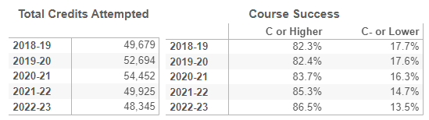
Average number of RS students graduating with a degree completed:
257
RS Students
are Successful!

Slide 12
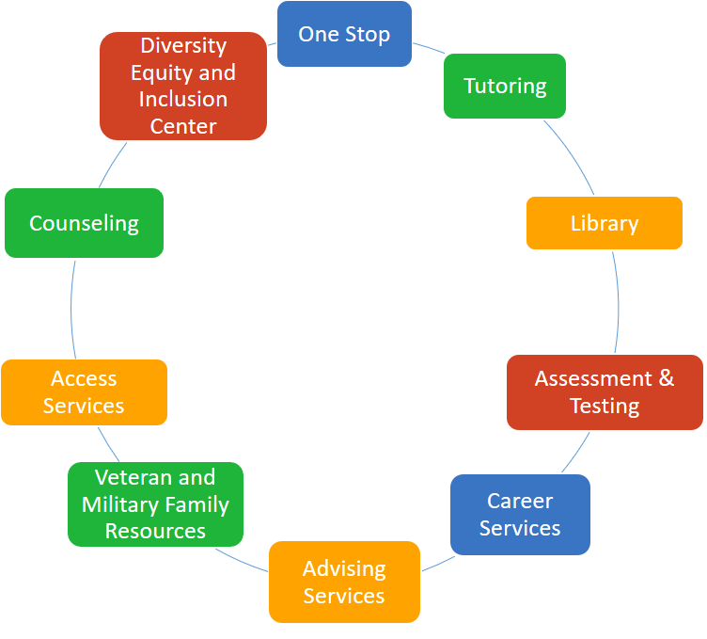
Support Services on Campus:
Free tutoring for all students
Free, confidential counseling
Study Abroad
On-campus job opportunities
Access Services

Slide 13
Education Planners vs.
High School Counselors
Who issues the diploma decides what counts
Work with both HS Counselors AND Educational Planners on a regular basis

Slide 14
The College Cycle
WEEK 2
Class schedule for next quarter final
WEEK 2-5
Meet with your Ed Planner to plan next quarter
WEEK 7
Current student registration starts
2 WEEKS BEFORE QUARTER
Tuition Due Date
QTR BREAK
Get books and supplies for next quarter

Slide 15
Student Online Tools
Your student can schedule an appointment with their Educational Planner through their mySPSCC account through Compass
The student can choose a time and day that works best for them to have a 30 minute meeting to plan their education at SPSCC
mySPSCC account allows students to access their email, registration, Canvas, Compass and transcripts
Compass is used to access their Success Network and Degree Planner
Canvas is used to access their online classroom, assignments, grades and class discussion boards

Slide 16
When RS doesn’t work out
Graduating from high school is the number one priority
Talk with your student’s high school counselor and SPSCC Educational Planner to see what is the best option
Consider going back to the high school- the college transcript is permanent!
Other Dual Credit Options

Slide 17
Other Dual Credit Programs
College in the High School
CTE Dual Credit
AP & IB
What is it?
Dual credit funding program in which college curriculum is taught at the HS. | Dual credit program though HS CTE classes that are articulated with a community college. | Opportunity to earn college credit while in rigorous HS classes.
Sophomores, Juniors, & Seniors | Any HS class standing | Any HS class standing
Eligible to enroll in the HS course | Eligible to enroll in the HS course | Eligible to enroll in the HS course
No charge | No charge (for SPSCC articulated courses) | No charge for classes. Fee for exams.
Who can participate?
How do I qualify?
Approximate Cost
Notes:
Running Start isn’t the only dual credit option that is offered for high school students. College in the High School, CTE Dual Credit, and AP/IB are other programs that can give you college credit. The main difference here is that Running Start is housed at the college, while these other dual credit programs are still taught at your high school. Additionally, programs like AP/IB only offer college credit if you get certain scores on their exams.

Slide 18

Policies & Procedures: FERPA
Academic records are protected by federal law
Even though participants are under 18, SPSCC cannot release educational records to parents, families, guardians, or friends without the student’s consent
Attendance and class performance are not tracked at the college the same way as at the HS
Release of Records Form – Submit to One Stop with Photo ID
Notes:
One major difference that you’ll notice between high school and college is that your parents or guardians do not have the same access to your academic records here at SPSCC. All college students, even though you may be under 18, are protected by federal legislation called the Family Educational Rights and Privacy Act, or FERPA. Among other things, this law states that we cannot release educational records to anyone other than the students themselves. Access to those records can only be granted through a Student Consent for Release of Records form. If you want your parents or guardians to be able to access your grades, pay your tuition and fees, or talk with your instructors, you will want to complete and submit this form. If a form is not submitted, or if someone other than the people that you have listed on the form tries to contact us, we will not share any information. It’s also important to note that academic records here at the college will look different than records at the high school. Attendance and grades aren’t necessarily tracked in the same way, so parents and guardians will need to temper those expectations.

Slide 19
High School vs. College
Instant access to grades and attendance
Student has to log into Canvas to show you their grades
Adults telling students what to do and giving time in class to complete assignments
Student is responsible knowing when things are do- no one is going to remind them
HS Teacher will meet with parents to discuss issues
College instructors will not meet with parents unless the student is present
Parent can call the school or show up to talk to admin or staff
Student must be present for any transaction at the college

Slide 20

Supporting Students Doing the Work
Emotional support because college is difficult
Support their learning by engaging in what they are doing
Help them with time management – homework is what makes students successful
Help them with their Running Start Enrollment Verification Form every quarter

Slide 21
Scheduling
Quarter System vs. Semester System (Fall, Winter, Spring)
Breaks don’t line up
Taking classes at both high school vs. just SPSCC
Students register for their own classes through MySPSCC Portal
Meet with Advisor each quarter prior to registration
Online classes vs. in-person classes

Slide 22
RUNNING START ADVISORS
Online and outlying districts | Jessica Egli | jegli@spscc.edu | 360-596-5373 | Olympia Campus
Tumwater School District | Neha Guarente | nguarente@spscc.edu | 360-596- 5506 | Olympia Campus
North Thurston School District | Tracy Moore | tmoore@spscc.edu | 360-596-5461 | Olympia Campus
Yelm and Rainier School Districts | Joe Torres | jtorres18@spscc.edu | 360-596-5321 | Olympia Campus
Olympia School District | Lu Swenson | lswenson@spscc.edu | 360-596-5347 | Olympia Campus

