Slide 1
Welcome to Running Start!
2024-2025

Slide 2
RUNNING START ADVISORS
Online and outlying districts | Jessica Egli | jegli@spscc.edu | 360-596-5373 | Olympia Campus
Tumwater School District | Neha Guarente | nguarente@spscc.edu | 360-596- 5506 | Olympia Campus
North Thurston School District | Tracy Moore | tmoore@spscc.edu | 360-596-5461 | Olympia Campus
Yelm and Rainier School Districts | Joe Torres | jtorres18@spscc.edu | 360-596-5321 | Olympia Campus
Olympia School District | Lu Swenson | lswenson@spscc.edu | 360-596-5347 | Olympia Campus

Slide 3
AGENDA
Things you need to know to start fall quarter
How SPSCC can support you
How to get involved
Questions

Slide 4
AGENDA
Things you need to know to start fall quarter
Paper airplane activity
How SPSCC can support you
How to get involved
Questions
Tour

Slide 5

YOU DID IT!
    ☑ View the Running Start Information Session and attend a Q&A
    ☑ Apply for Admissions
    ☑ Activate Student Accounts: SPSCC Student email (ClipperID) and ctcLink
    ☑ Qualify for College-Level English via test or documentation
    ☑ Plan courses with HS Counselor
    ☑ Complete your New Student Advising and Registration (NSAR) session.
    Check your SPSCC student email or https://spscc.edu/start/registration for the link!
    ☑ Complete Enrollment Verification Form with HS Counselor and Parent
      Submit to the college by tuition due date!
    ☑ Enroll in classes for fall 2024

Slide 6
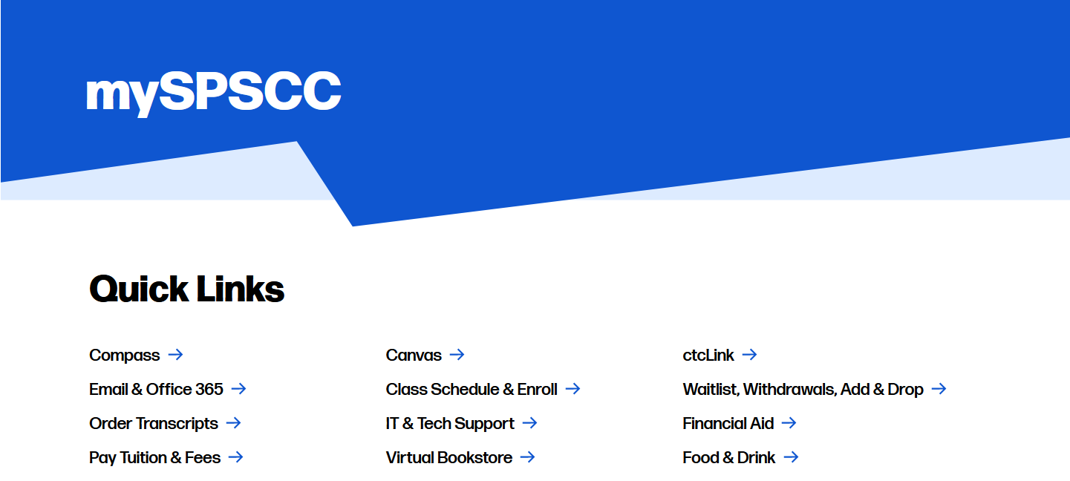
YOUR STUDENT PORTAL:
Notes:
Speaking points
Go through major tiles – ctcLink, email, canvas, compass and highlight others

Slide 7
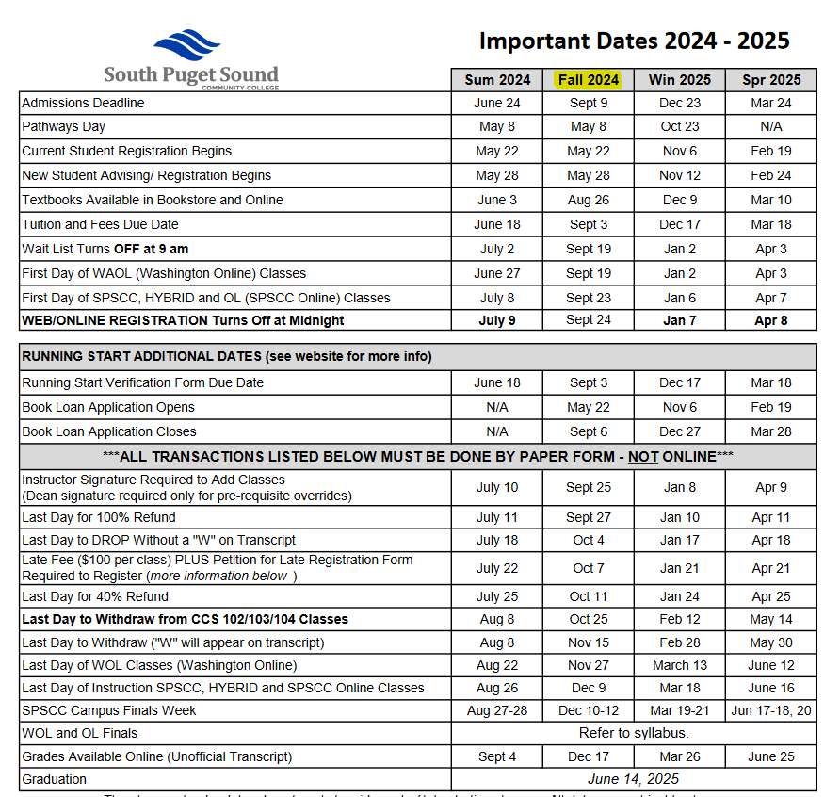
IMPORTANT DATES
First day of class: 9/23/24
Instructor Signature Required to Add Class: 9/25/24
Last Day to Drop Without a W: 10/4/24
Winter Quarter Registration Begins: 11/6/24

Slide 8
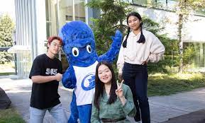
QUARTER vs SEMESTER SCHEDULE
 | Sept | Oct | Nov | Dec | Jan | Feb | Mar | Apr | May | Jun | Jul | Aug
SPS | Fall Quarter ~ 12 weeks |  |  |  | Winter Quarter ~ 12 weeks |  |  | Spring Quarter ~ 12 weeks |  |  | Summer Quarter
HS | Fall Semester ~ 16 weeks |  |  |  |  | Spring Semester ~ 16 weeks |  |  |  |  | Summer Term
SPSCC important dates don’t line up with the high school

Slide 9
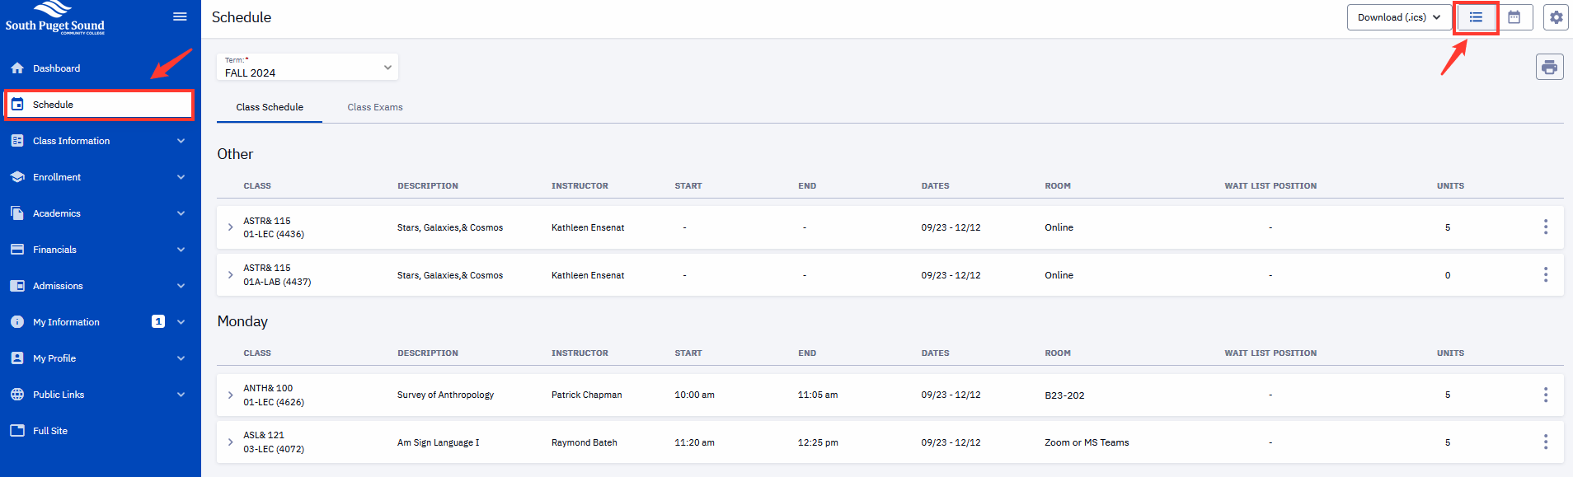
CLASS SCHEDULE

Slide 10

POLICIES & PROCEDURES: FERPA
Academic records are protected by federal law
Even though participants are under 18, SPSCC cannot release educational records to parents, families, guardians, or friends without the student’s consent
Attendance and class performance are not tracked at the college the same way as at the HS
Release of Records Form – Submit to One Stop with Photo ID

Slide 11
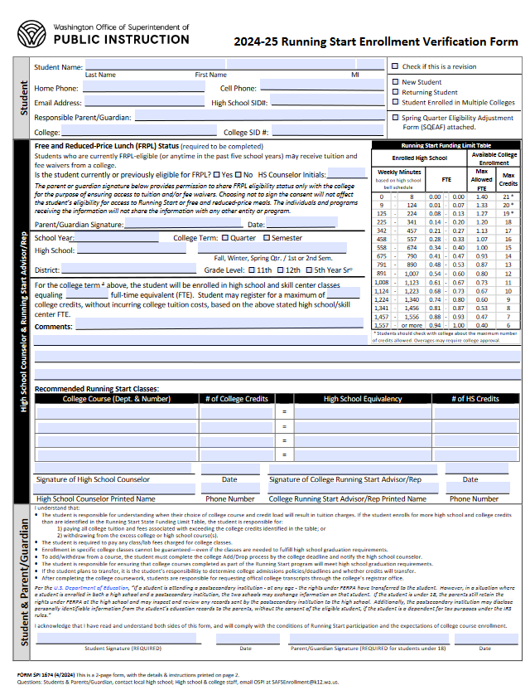
THE “RSEVF”
Running Start Enrollment Verification Form
Submit before Tuition Due Date EACH QUARTER!
  Approximately 4 weeks prior to start of each term

Slide 12


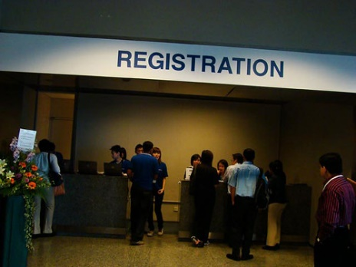
I AM REGISTERED, NOW WHAT?
Textbooks
Waitlists
Web-Registration
Winter Quarter Registration

Slide 13
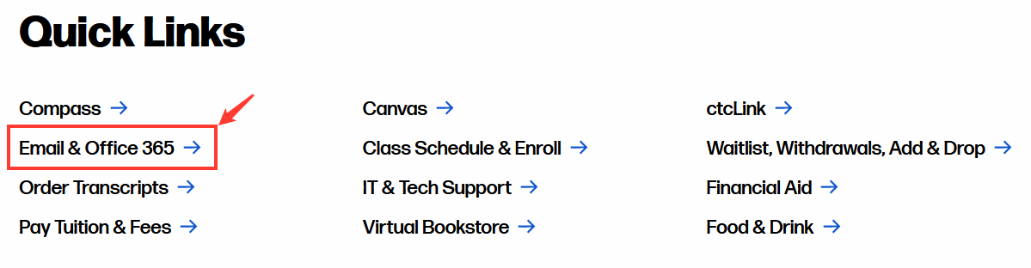
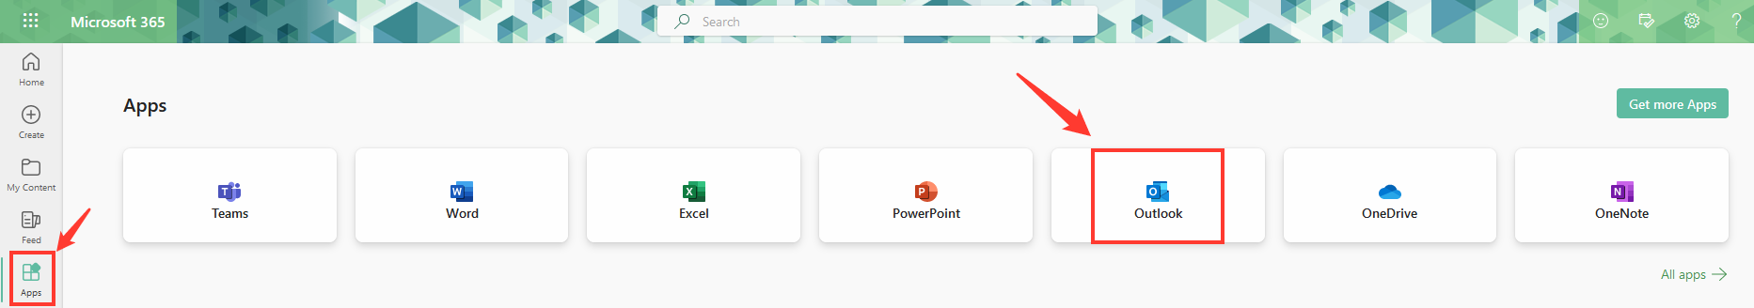
READ YOUR EMAIL!

Slide 14
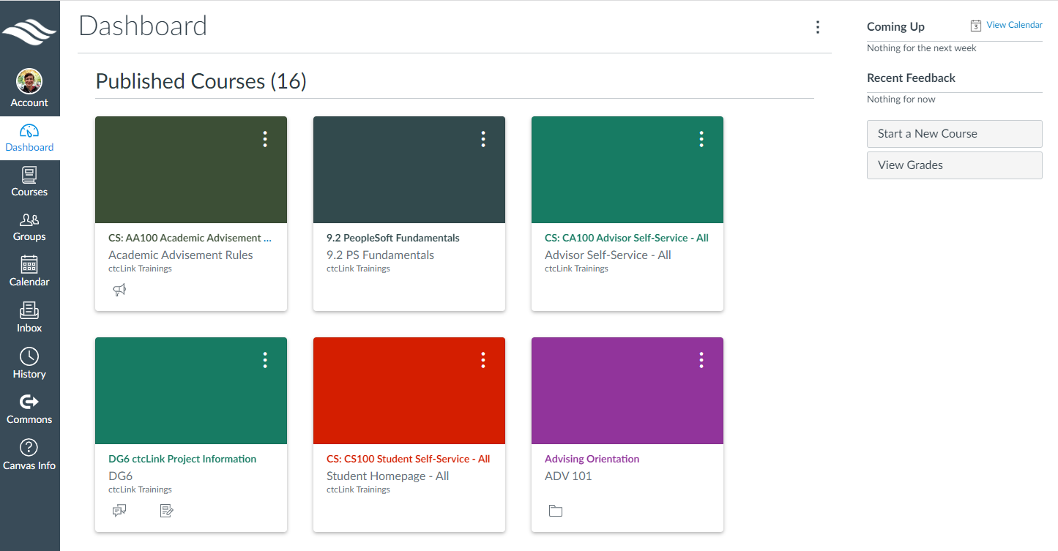
HOW TO “CANVAS”

Slide 15

BEING A RUNNING START STUDENT
What are you the most excited about?
What are you not so excited about?

Slide 16

BEING A RUNNING START STUDENT
What are you the most excited about?
What are you not so excited about?

Slide 17
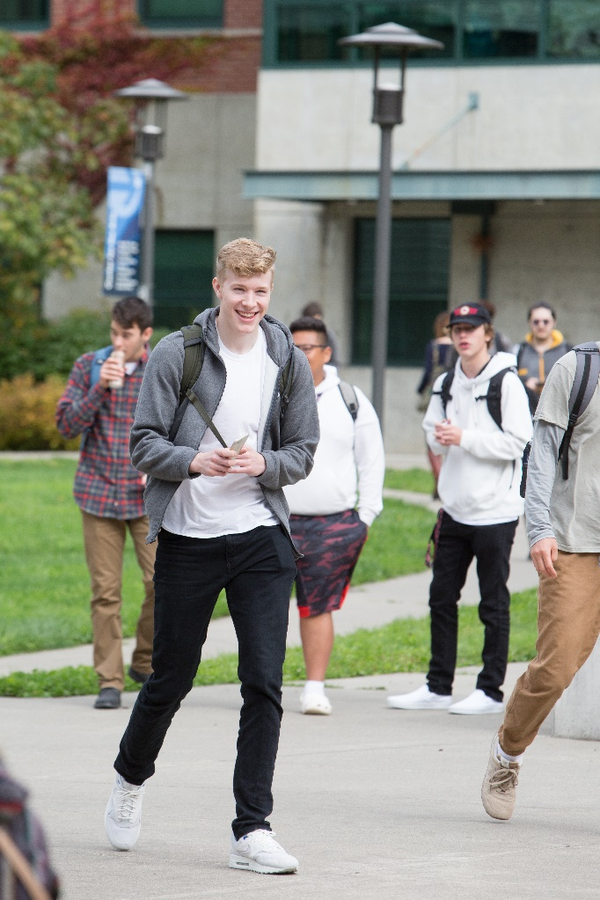

STUDENT SUCCESS NETWORK
  Building 22, Olympia Campus, 2nd floor
    Diversity, Equity, and Inclusion Center
    Counseling & Access Services
    Veteran and Military Family Services
    Advising and Career Services
    One Stop
    Financial Aid
    Assessment Center
= Also available virtually
Notes:
Speaking points
Highlight ACT Center: what we do and when you should meet with us

Slide 18
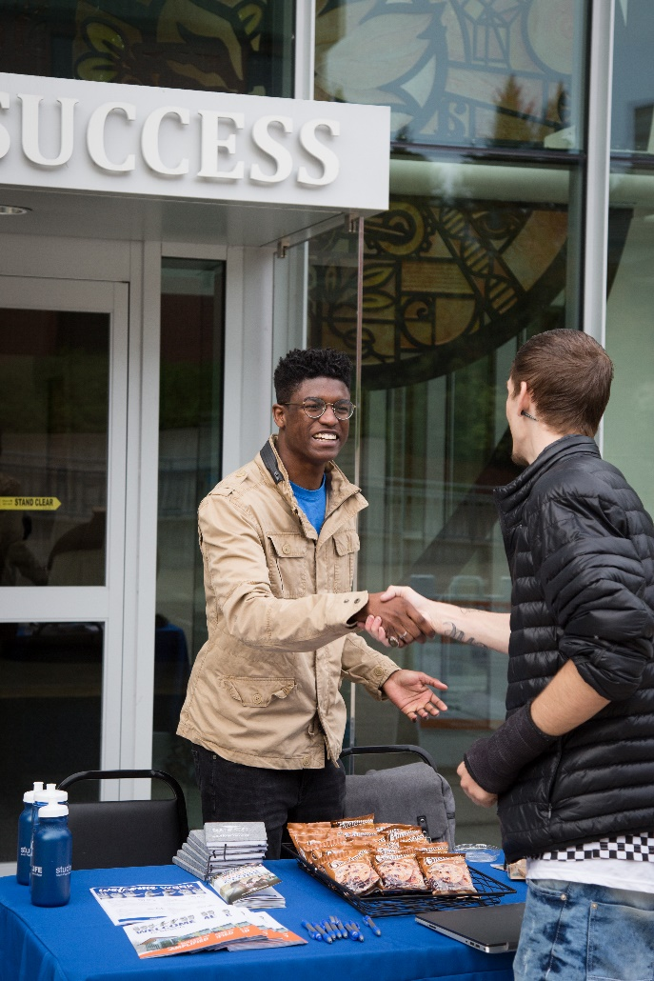
STUDENT SUCCESS NETWORK
  Building 22, Olympia Campus, 1st floor
    Library
    Center for Teaching & Online Learning
    Clipper Corner Café
    Personal Support Center
    Learning Support Services – East
      Math, Science and Accounting help
    Learning Support Services – West
      Writing, scholarships and language assistance
      Resume/Cover Letter assistance
= Virtual tutoring is also available!
Notes:
Speaking points
Tutoring is free of cost
Center for Teaching and Online Learning can help with your Canvas/class access

Slide 19
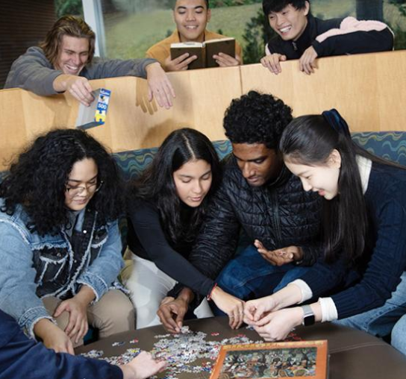
THIS IS YOUR (STUDENT) LIFE
Student Clubs
The Big Event
9 active clubs, including Gaming Club, Active Minds, Creative Writing, and Rainbow Spectrum
Don’t see what you want? Start your own!
Yearly in June
Bouncy rides
Animals
Photo booth
Games
Food truck!

Slide 20


QUESTIONS?

